Slide 1
Flow
1830 – 1845: General Intro to HO Year
1850 – 1910: Internal Medicine Sharing
1910 – 1930: Light Refreshments
1930 – 2000: General Surgery
2000 – 2020: Orthopaedics
2020 – 2035: Obstetrics & Gynaecology
2035 – 2050: Paediatrics
2050 – 2100: Q&A

Slide 2
PGY1 Sharing
LKC
29 Jan 2020

Slide 3
Pre-MBBS
LKC
M4 to PGY1 timeline
How to start thinking about HO postings
Things we wished we knew as a student

Slide 4
Timeline
M4 till PGY1
M4 Summs
IRP
SAP
1 July
Oct - Dec
Feb - Apr
2020
2021
JAN
FEB
MAR
APR
MAY
JUN
JUL
AUG
SEP
OCT
NOV
DEC
JAN
FEB
MAR
APR
MAY
JUN
JUL
AUG
SEP
OCT
Electives
MBBS
PGY1
10 Aug
Early Jan
1 May 2021

Slide 5
How to choose HO postings?
Interests
Location
Contraindications?
Medical vs surgical
Alive vs not alive
SI
Goal
Where do I start??
NHG
Singhealth
NUHS
Explore
Open/close doors
Chill

Slide 6
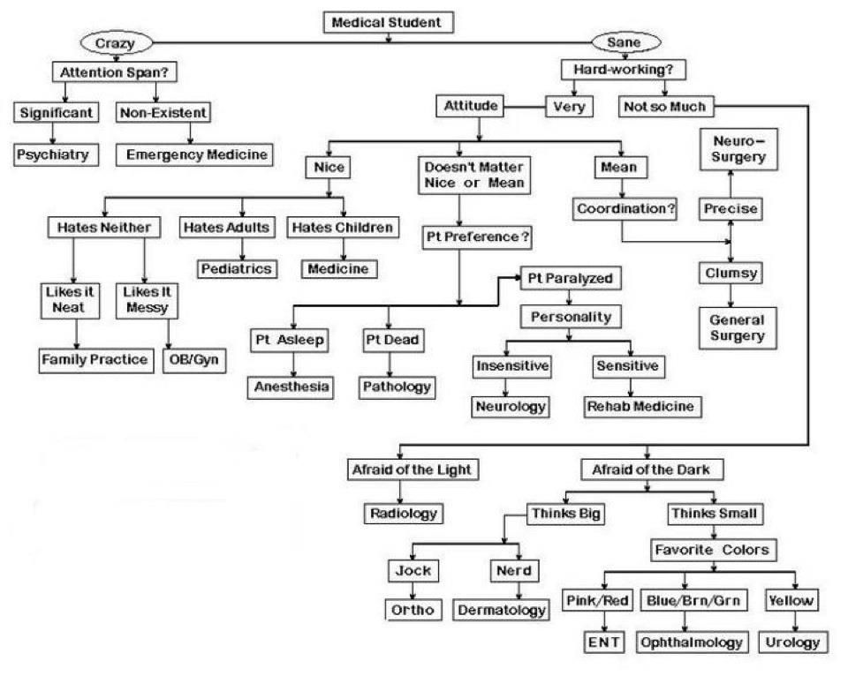

Slide 7
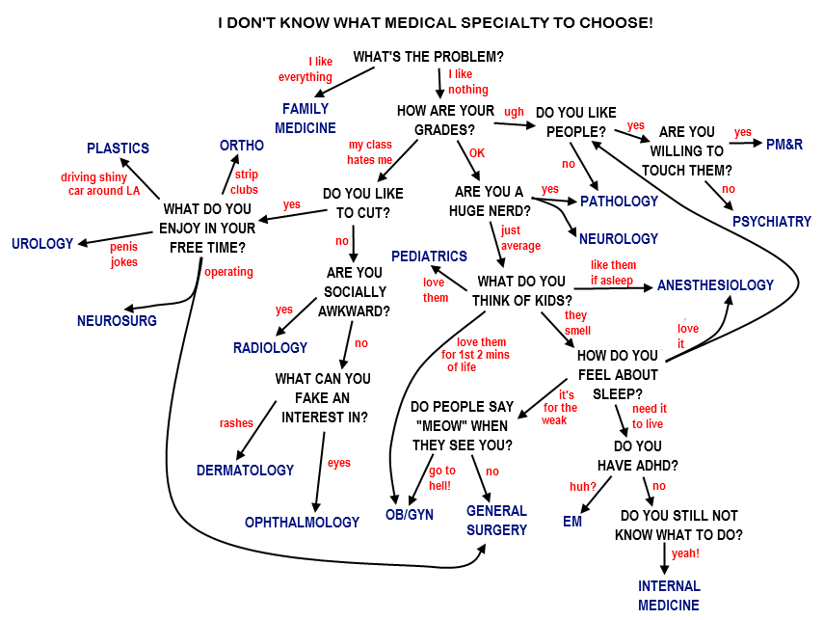

Slide 8
What can I do now?
Priority: M4 summs → electives → MBBS
Start thinking about it!
Electives
Research +-
Talk to your seniors

Slide 9
Words of wisdom
Enjoy med school – many of us took it for granted
Med school does prepare you for HO
HO postings don't make or break your career
What makes a good medical student doesn't necessarily equate to a good HO
Strive to be the best version of yourself
Things we wished we knew as a medical student

Slide 10
Post-MBBS
Overview of PGY1
Now till PGY1
Day of a PGY1
How to be a functional HO and more
Nurses
Seniors accounts
Words of wisdom

Slide 11
18 weeks Till Start of HO ☺

Slide 13
PGY1
3 Postings
Calls
Responsibility
4 months each
Allocations random
1 IM + 1 surgical + 1 elective
x1/52 AL per posting
$4000/mth + call pay
$666 PTF (prorated)
sigh sigh sigh sigh sigh sigh sigh sigh sigh sigh sigh sigh sigh sigh sigh sigh sigh sigh sigh sigh
Making medical decisions
Working with colleagues
Dealing with AHP / nurses / families
Working under bosses
An overview

Slide 14
SAP till HO
Learn Learn Learn, and have fun!!
Ward work
Calls
Low stakes
Rounds / Exits
Procedures
Blues
Comms
Working in a team
Long hours
Thinking like a HO
Prioritizing
Best time to make mistakes and learn
You can really contribute to the team
Explore interests

Slide 15
Life of a PGY1
Sleep
Travelling
It’s a luxury.
Grab
MRT
Drive
Free time
Ward work +- call
Yes it does exist
Hours depend on posting
Weekend rounds

Slide 16
PGY1 starter pack
Team player
Learn to work with different people
Especially if you might not get along
Don’t half-ass your work.
Golden rule applies
Work is tough, but remember why you chose medicine
Be keen to learn, ask questions
Sometimes that means being thick-skinned
Trustworthy
Efficient
Knowledgeable
Wholesome

Slide 17
PGY1 starter pack
Team player
Trustworthy
Efficient
Knowledgeable
Wholesome
Be sincere
Be keen to learn, ask questions
Sometimes that means being thick-skinned
Learn to work with different people
Especially if you might not get along
Don’t half-ass your work.
Golden rule applies
Prioritizing
Work fast but effectively
So you can focus your attention on other things
Less referrals (hopefully)

Slide 18
Nurses
What you should understand

Slide 19
Nurses vs Doctors
Nurses | Doctors | Learning Points
Protocols, protocols, protocols – limited role for clinical judgement; effective as a first response / sieve | Clinical assessment, evidence based medicine, tailoring management to patient profile | Teach your nursing colleagues to help them improve in clinical assessment Accept that protocols exist
Formal training required for each procedure – safer approach, accountability | See one, do one, teach one | Accept that we work in a different way and help the nurses where needed – they will help you back
Facing patients daily for most of their daily needs – will having to deal with unreasonable requests, angry patients with no option to hide in MO room | Facing patients for short periods of times for mostly clinical need | Understand that sometimes nurses may call you on call for non-urgent matters because they are stressed by patients / families
Shift work – each shift has different work load, but night shift has tasks to clear as well, which may not be aligned with on call doctor’s priorities | Primary team and on call team | Understand that sometimes nurses have a different sense of prioritisation Do not act out on call and politely explain your troubles

Slide 20
Do’s and Don’ts
Do not shout at nurses / other allied health staff
Do not act out in response to an “unreasonable request”
Do not get personal when scolding the nurses (if you must)
If you must, point out the mistake or issue in a polite and professional manner
Documentation
How to better interact with nurses
Notes:
Story time – coHO of mine got in trouble for being rude to nurses, nursing sister escalated to HOD, putting his PGY1 progress into review ie potentially could fail posting if the bosses supported the nurses
Also P2 la if you’re well known to be rude during your P2 month, expect them to highlight this to the PGY1 committee some way or another

Slide 21
What your seniors feel
Best moments
Worst moments
When your patients / their families remember you and thank you for the hard work and care given
Knowing that you made a difference to your patient’s care (be it big or small wins)
When your seniors affirm you and the work you’re doing
Exiting early
When your patient comes to harm directly/indirectly cause of you
When you’re solo HO and you have 26 patients and a sickie and 5 referrals to make
When politics get in the way of patient care

Slide 22
Words of wisdom
You will have bad days, learn and move on!
Take breaks when you need them – spend time pursuing hobbies, with friends/loved ones
There’s lots of things you can learn from your peers/seniors – pick up on every good value/practice you see and use it to improve yourself!
You’re never a lone island – help one another it makes a big difference
As you prepare for PGY1

Slide 23
Thank You
Ken / Sundheep / Weicher
Our.name@mohh.com.sg

