Slide 1
Ortho
Bro bro bro bro bro

Slide 2
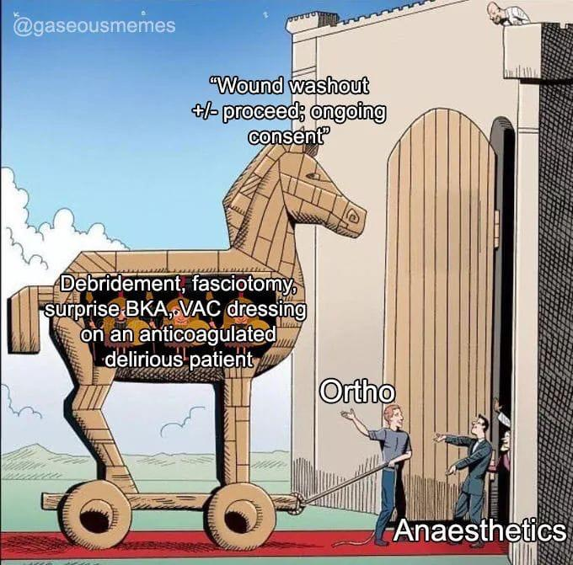
Ortho vs GS the similarities
MO and above spend most of their time in clinic / OT – HOs have the responsibility of running the wards
Management of drains, bleeding etc.
PFO, PORV, listing etc.
OT day = elective admissions
Patients usually spread across the hospital, lots of motivation to discharge everyone stat
Trauma activation! (experience varies)

Slide 3
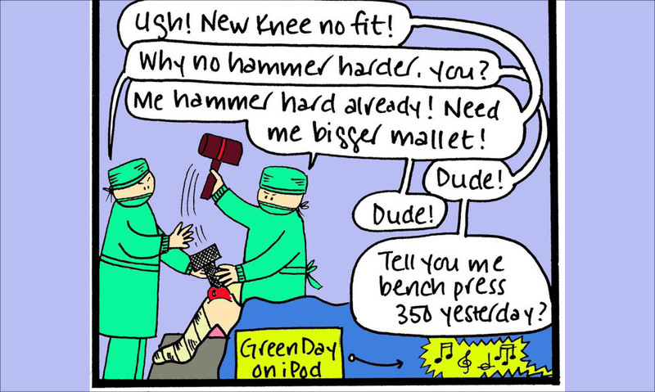
Ortho vs GS the differences
Patients are usually less sick
Bosses usually less bothered by the bloods / IOs
Scans are usually less urgent
People are generally happier
Meetings = in depth discussion on techniques, implants = confused HOs

Slide 4
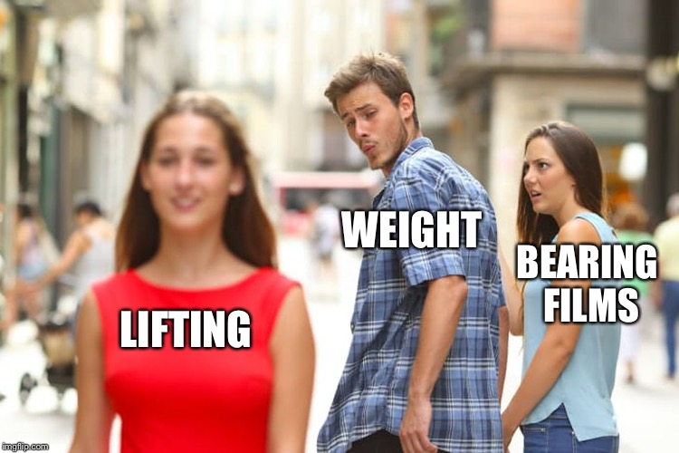
How to Ortho
History taking
Social b/g – hand dominance, ADL status, occupation, hobbies
Mechanism of injury (what other injuries to look for on examination)
Risk factors for infection, non-union / malunion, osteoporosis, pathological #
Physical examination
Usual ortho examination techniques – special tests!
Look feel move is your friend
ATLS secondary survey
Learn from your seniors
Investigations
Know the right imaging to order

Slide 5
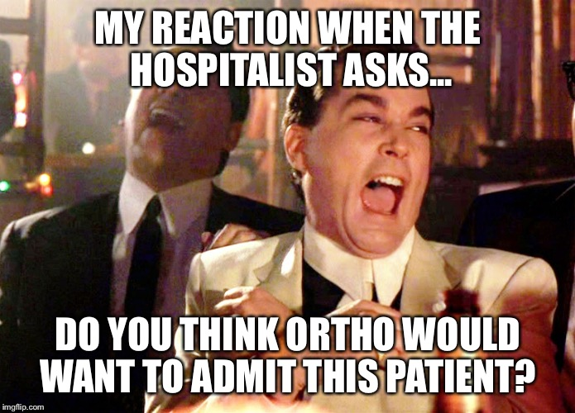
How to Ortho
Calls
Truly, you are the medical consultant – good to have your medical / surgical CTSPs brushed up; rarely have ortho specific CTSPs
Anything you don’t know, get ready to refer GM R1 unless your MO/Reg is holistic / fresh
Taichi masterclass (truth is most fractures don’t need admission)
Learning
Orthobullets is your friend
Calls are the best chance to see and do actual ortho stuff
If your department has a meeting – lots of learning comes from listening to your seniors discuss ortho cases
Usually have more time during posting to go OT with the team

Slide 6
END

