Slide 1
IMHO
Russell, Sundheep,
Justin, Ken
(PGY1, Batch of 2019)

Slide 2
Notes:
Take everything said today with a large pinch of salt. Opinions differ, and situations will change by the time you start work.

Slide 3
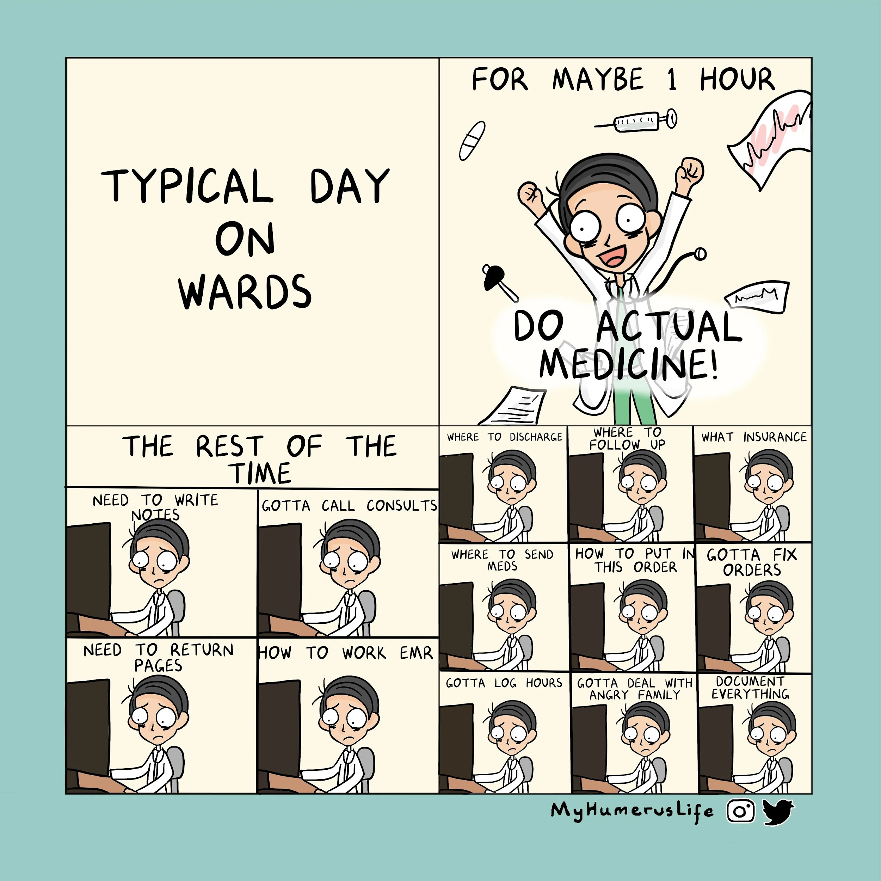
A Typical Day
Pre-Rounds
Rounds
Changes
Lunch
Teaching
Exits
Notes:
Probably have gone through what an average day in IM is like during your M3 IM posting
But probably didn’t stay around during “changes” or “exits” - not that much learning value anyway
Just here to take you through an average day
Pre-rounds: starts maybe 6+. New patients: See admission notes. Revisit Hx, PE. Trace on-call’s Ix if not traced. Old patients: Note overnight events, check vitals, IOs, new results. Talk to and examine patient. Come up with preliminary plans
Rounds: May round with registrar first, or directly with consultant. Usually better to go through with reg first if still very new, so she/he can identify things that were missed
Changes: ordering Ix, Mx (or anything else, especially with CPSS and EPIC where everything needs ordering). Referrals / blue letters / phone consults. Co-ordinating care and discharge planning (People: PT, OT, ST, MSW, Ward resource nurse, patient navigator, families. Applications: AIC for CH referrals, home nursing foundation, home hospice)
Lunch:
Teaching
Exits: Usually on paper for the patients who are well. Physically review the ones who are more sick.

Slide 4
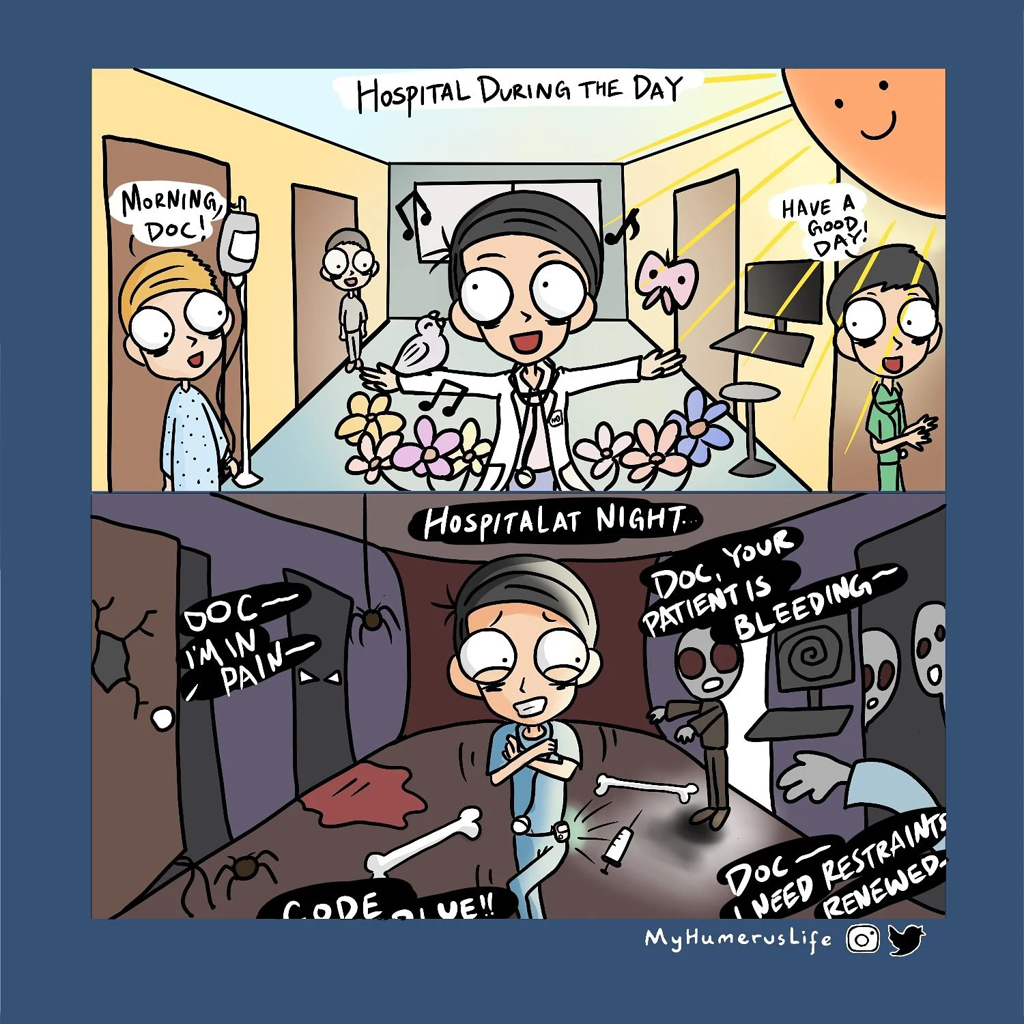
A Typical Night
Handovers
New admissions
CTSPs
Miscellaneous calls / requests
Post-call rounds
Post-call cover
Notes:
Handovers: trace bloods, scan reports, blue letter replies. Usually quite brainless if good instructions given. If not then clarify with person who is handing over
New admissions: Pre-clerk (NEHR for PMHx, previous Imaging/Cardiac Ix /Cultures/HbA1c, order old meds, look at ED Hx / PE / Ix, retake Hx and PE, order more Ix/Mx), clear with MO / see together with MO. Eventually most places it gets cleared by Reg (besides SGH)
CTSP: any presenting complaint
Misc calls / requests: sleeping pill, don’t want to eat medicine, don’t want set plug, family wants update at 9pm
Post-call rounds: Try to stay awake
Post-call cover: finish changes, then write a handover text with things to trace and act on. Also good to physically / verbally handover to your colleague so they can ask you things.

Slide 5
A Typical Weekend
Rostering
Cross-Coverage
Notes:
Usually 1 more experienced MO will kindly take on the role of rostering weekends
If not then you may have to do it. Just try to make sure everyone has the same number of weekends they need to be working (usually 3-4 days / month?)
Cross-coverage: You will round additional patients on the weekend. Try to write a handover text on Friday if you’re not rounding on Saturday, (or write on Saturday if you’re not rounding on Sunday)
After rounds and changes, handover. No exits
A lot less gets done over the weekend. Non-urgent referrals won’t get made, non-urgent MRI/CT scans won’t be done -> less things to do, less things to trace

Slide 6
Comparisons - Day Work
NUH | NTFGH | SGH | CGH | SKH | TTSH | KTPH
GM: 20+pt/team split betw 3-4 jnrs Subspec: 3-20 pt/team betw 2-4 jnrs Geographical based (each con takes a specific location) Blues: usually call. Some eg. PSY no need CPSS | 25-50 pt/team, split betw 3 jnrs Geographical (GM) Consultant based (subspecs) Blues - all call, except Pall. But they may call to ask more qns. Chang teams often - weekly EPIC: very good (eg smart text), but steep initial learning curve. annoying stuff - updating problem list and needing to order every single thing. | 15-40 pt/team __pt/person Both Geographical and consultant based teams No rotations to subspecs Blues - all written (no call), unless for phone consult Citrix: easy to use, can trend results easily, ordering meds on admission is easier | 3-30+ pt/team 1-15 pt/person Consultant based teams (patients everywhere) Good case variety Referrals online Med blues - usually no need call except Onco etc Surg blues - call IT: Citrix is good. documentation is paper for ward rounds but replies are mixed |  | 20-30 pt/team 5-8pt/person Geographical (GM + GM subspec) Consultant based (subspecs) Blues vary – call vs text CPSS | 30 pt/team 4-6 pt/person Geographical (Respi, AMU, some GM) Consultant-based (some GM) Referrals online Med blues - usually need to call except some (CVM, __) Surg blues - call IT: Citrix Documentation online now.

Slide 7
Comparisons - Subspec Exposure
NUH | NTFGH | SGH | CGH | SKH | TTSH | KTPH
Neuro ID Gastro Endocrine | Cardio Respi Gastro ID Endocrine Renal Neuro | Acute medical ward | Gastro Respi |  | GM Endocrine GM ID GM gastro Renal | Respi Renal Acute Medical Unit Diabetic Foot Unit

Slide 8
Comparisons - Calls
NUH | NTFGH | SGH | CGH | SKH | TTSH | KTPH
New admits: 0-20s Active float / passive call system | Split into active float and passive call Active float EOD from 4.30pm - 8am for 2 weeks. Admits can get heavy, usually 20-25 admits every night, can sleep abt 1 hour Passive call depends on luck. Sleep: min 0, max 6h. Post call usually around 12-1pm | New admits: 10-20 Actives + passives Nurses will call for everything Not much sleep. Maybe 30min - 1h | New admits: 5-20 Actives + passives Workload dependent on level coverage Sleep: min no sleep max sleep 4-5h |  | New admits 10-30 Full call – active + passive Half call – passive May be changing to active / passive calls March 2020 Nurses will call or HMS Sleep 0-1hr (most of us don’t bother collecting the call room card) | New admits: 10+, sometimes <10 Actives + passives Workload dependent on level coverage Nurses will call or tigertext Sleep: usually have 1-2h at least

Slide 9
Income
Earn how much? How best to pay off medsku debt?
Quit before it’s too late
Previously 3.6k / month, increased to 4k/month (excluding calls, before CPF)
Weekday call $120, Weekend/PH call $165 (I’m actually not sure if this is CPF deductible). 4-5 calls/month.
Works out to about 4.5+k / month

Slide 10
Residency
REFEREES:
How important are recommendation/referee letters from superiors in the departments HOs rotate through, in terms of applying for residency, given the limited duration of each rotation? In terms of the value they can add to a residency application, what distinguishes the input of supervisors during housemanship from the input of LKC faculty/house tutors?
Residency application portal: all they really see is the letters of recommendation
HO supervisor VS LKC house tutor: not sure. Best if they are both haha
MOHH Interview: ethics scenarios. IMHO not great for distinguishing candidates
Singhealth: internal interviews, veto list, ask people who’ve worked with applicant
NHG: no internal interview, has semi-formal tea session. Will ask people who’ve worked with the applicant
Notes:
Residency application portal and LOR. If a consultant agrees to write for you, invariably they will write something nice. If everyone has something nice written about them, what distinguishes one applicant from the other?

Slide 11
Residency
EXPERIENCE / CLUSTER EXPOSURE:
Does the cluster one does housemanship in affect chances of getting into residency in that same cluster? I would like to know a breakdown of how actual life is and the possible postings we should choose to maximise our experience for certain specialities we are hoping to join the future.
If you haven’t worked within that cluster, it’s difficult to apply to its residency.
If you want to apply for IM in your first year, try to get it as 1st or 2nd posting (if IM as 3rd posting, application will start before your 3rd posting starts)
RESEARCH: How important is research in applying for residency? Is there time for research as a HO?
Appears to be more useful in surgical disciplines
Working relationships may be more important
Helps if already started research in school (easier to continue than to start totally afresh)

Slide 12
National Service
For the guys resuming National Service, how is the re-enlistment procedure like, and what can one do to boost residency application chances during NS itself?
2 cycles of re-enlistment (start of year, mid-year)
Finish PGY1 in April 2020.
If get into residency -> Interrim posting + R1 until June 2021 -> go back army in July 2021
If no residency -> Interrim posting until June 2020, officially start MO year in July 2021 and finish 1 MO posting (6 months). -> go back army in Jan 2021
Boost residency application chances during NS: somewhat difficult (out of sight, out of mind, if no one sees you working, it’s hard to get accepted). Stay medically / mentally active: take exams, study. But ultimately it’s hard to prevent brain atrophy when not practicing full time.

Slide 13
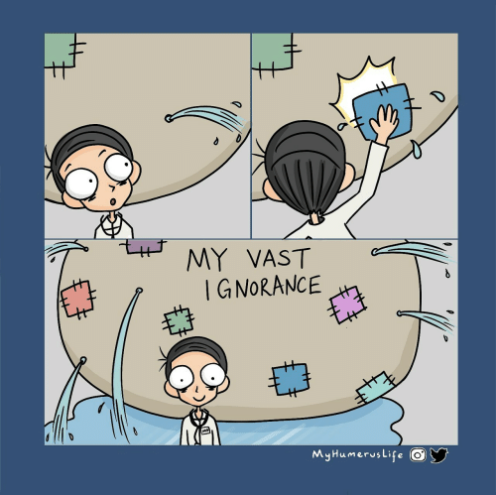
Q&A

