Slide 1
Paediatrics Posting in KKH

Slide 2
Overview
Why paediatric posting?
What to expect as a HO?
Day to day ward work
Exposure to subspecialties
Calls
Procedures
Teachings
Colleagues, cultures
How to prepare for it?

Slide 3
why
“Children are not miniature adults”
Communication skills with parents and children
Pro-teaching culture
Interest in paediatrics, family medicine and emergency medicine

Slide 4
Day as a HO
Time | To do
6.30- 6.45am | Prerounds: SOAP, any overnight events? Vitals? New patients?
8.30am | Rounds with registrar
9.30am | Rounds with consultant
11am | End of rounds, do changes such as ordering investigation/ medications/ referrals/ discharges
1pm | Lunch! Hopefully hahahha
4pm | Round everyone again and exit with registrars
5pm | GO HOME
FYI, weekends are pretty much the same in the morning except that manpower is 50% and need to go for call after.

Slide 5
Common cases
Respiratory: URTI, LRTI such as bronchitis, bronchiolitis, asthma
Gastrointestinal: GE
Neonatal pyrexia
Neonatal jaundice
Poor feeding, keep crying etc

Slide 6
Variety of subspecialties
High Dependency
Need to present M&M to everyone in the department every Friday afternoon to prepare on-call team just in case there are code blues
3 ward rounds per day
Wider variety of patients such as complex care children (usually born with severe birth defects), DKA, severe asthma, strange things like maple syrup urine disease
Medical Oncology
Management of immunocompromised children, chemotherapy etc
Observe how seniors communicate with parents who may be stressed, anxious, worried ++
Gastroenterology
Hirschsprung disease -> stoma care, TPN etc

Slide 7
Calls
Coverage
Active HO: new patients admitted from 5pm to 8am from three wards and passive changes from existing patients in two wards
Passive HO: existing patients in four wards
Generally around 18-24 admits per night
CTSPs for fever/ desaturation/ difficult parents
Don’t worry about escalating, MO will have to vet through everything HO clerks and registrars will see all new cases admitted before 12am
Sleep is a bonus, or maybe entering a call room is a bonus

Slide 8
Procedures
This is a lie, they will FIGHT

Slide 9
Teaching, cultures, colleagues
Handhold posting
Seniors are generally very pro-teaching and particular about everything
Expects HO to escalate
Various teaching lectures to familiarise yourself
Colleagues are generally super nice, MOs will treat HOs to waffles during call at night etc

Slide 10
Preparation
Read your paediatric notes again, familiarise yourself with basic conditions and management
Forget about memorising dosages, eIMR/ seniors will guide you
Import acronym expansion from colleagues
Ask everything!!!

Slide 11
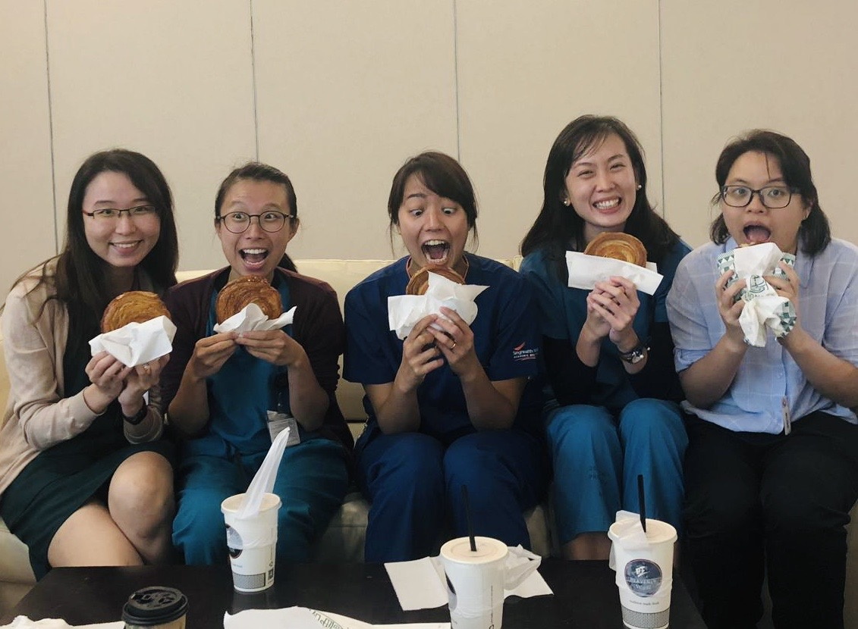
Thank you!
Xin Er
82884351
X.tang@hotmail.com

